Slide 1
i.MX platform Linux Case design
Zhen Xin
7/24/2014

Slide 2
Content
How to design a case
VTE test script style introduction
How to write a test script

Slide 3
How to design a case
How to locate the test point
Read related protocol document to list the test point.
Read the related chapter in user manual to diff the protocol document with controller feature (list the extra feature for controller).
Read the driver source code and talk with the driver module owner to get the detail messages.
Example:

Slide 4
How to design a case
Common test point
Clock gate check : check the clock gate is open/close.
Suspend/Resume : the module can work normally after suspend/resume
Stress test : Test this module can work normally for a long time.
Example:

Slide 5
How to design a case
Case priority
P1 the most fundamental support for this module
(normally a module has one or two p1 case)
P2/P3 functions and features supported in protocol document or controller
Example:

Slide 6
VTE test script style introduction
LTP (Linux test project)
Some extra app or global variable:
like : tst_res , tst_resm, tst_exit .etc.
like : TCID, TST_TOTAL, and TST_COUNT
you can see vte/lib/tst_res.c and vte/tools/apicmds/ltpapicmd.c to see the details.
Example: vim vte/lib/tst_res.c vte/tools/apicmds/ltpapicmd.c

Slide 7
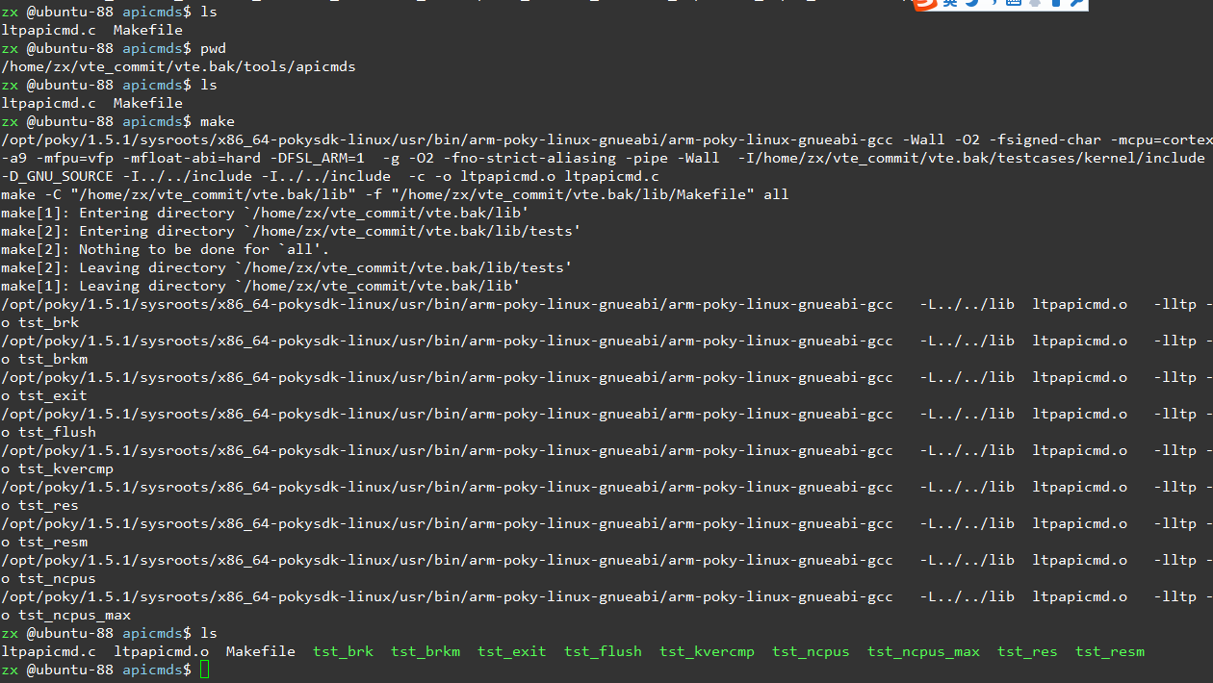
VTE test script style introduction
LTP (Linux test project)

Slide 8
VTE test script style introduction
Script style in vte
Style 1.
Example :
vim vte/testcases/vte_tests_suite/can_tests/can_client.sh
vim vte/testcases/vte_tests_suite/camera_test/camera_gamma_test.sh
Style 2.
Example :
vim vte/testcases/vte_tests_suite/usb_automation/usb_device_board.sh

Slide 9
How to write a test script
Common callee script (check the platform support )
plafm.sh
boot_mmcblk.sh

Slide 10
How to write a test script
Common styles
setup, cleanup, usage
Add function destription in each function
Example :
vte/testcases/vte_tests_suite/adc_tests/adc_test.sh

Slide 11
How to write a test script
How to add it into vte and submit it.
testcases/vte_tests_suite/Makefile
testcases/vte_tests_suite/vte_configs/imx6q_deconfigs
Example :

